Slide 1

DragonEvents
Final- DEMO

Slide 2
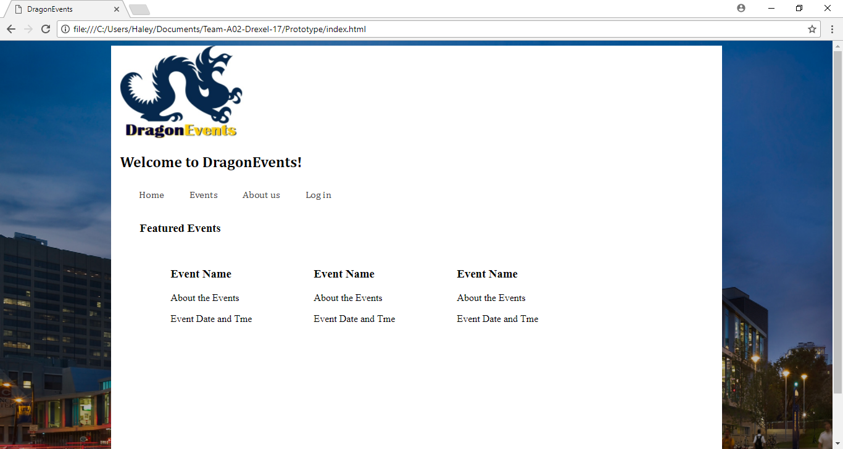
BEFORE
HOME

Slide 3
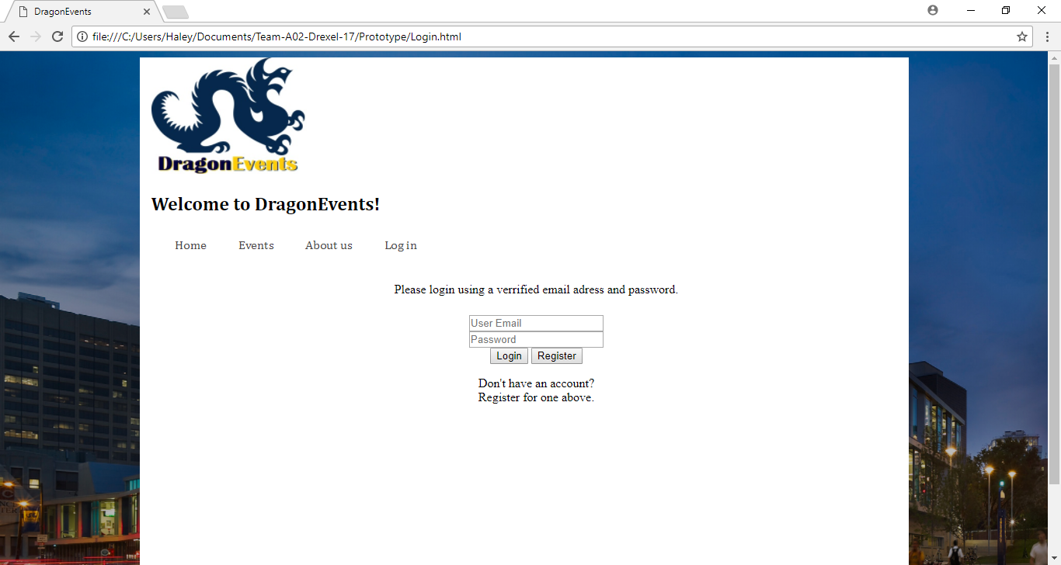
BEFORE
LOGIN

Slide 4
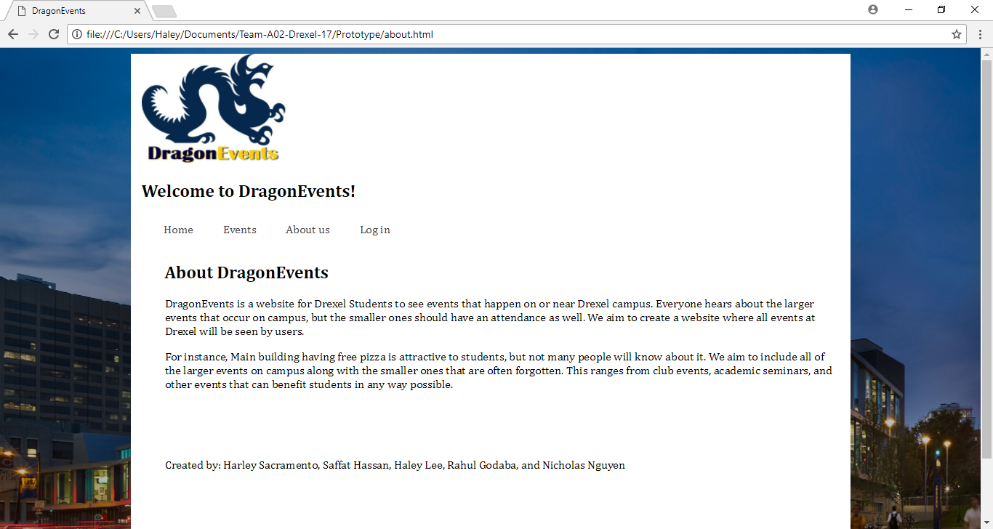
BEFORE
ABOUT

Slide 5
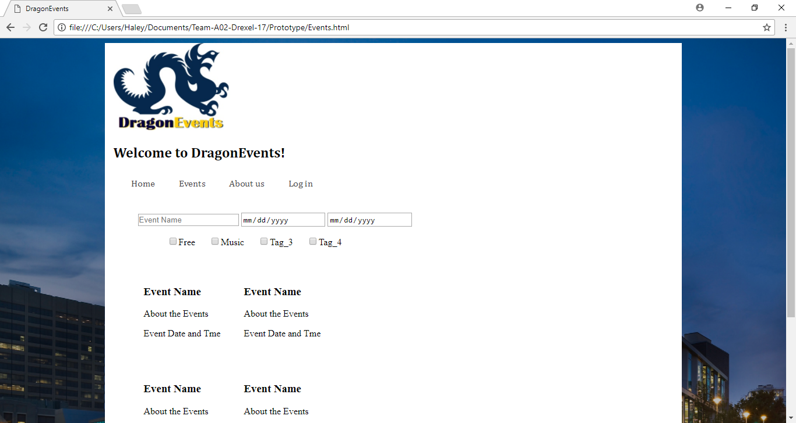
BEFORE
EVENT

Slide 6
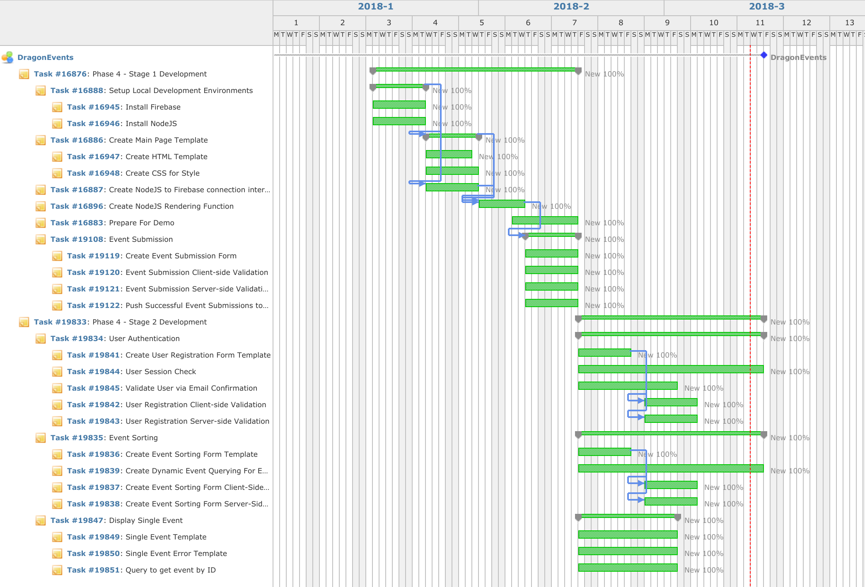
GANTT CHART

Slide 7
Original Scope
Submit & View Event
List events
User Registration & Authentication
Filter Events
Notes:
Completed
Submitting Events
Displaying Events
Todo
Displaying a specific event
User registration and login
Filtering events

Slide 8
Updated Scope
All items in original scope
Attempted to add images to each event
Validation for each form
Notes:
We Completed all items in our original scope

Slide 9
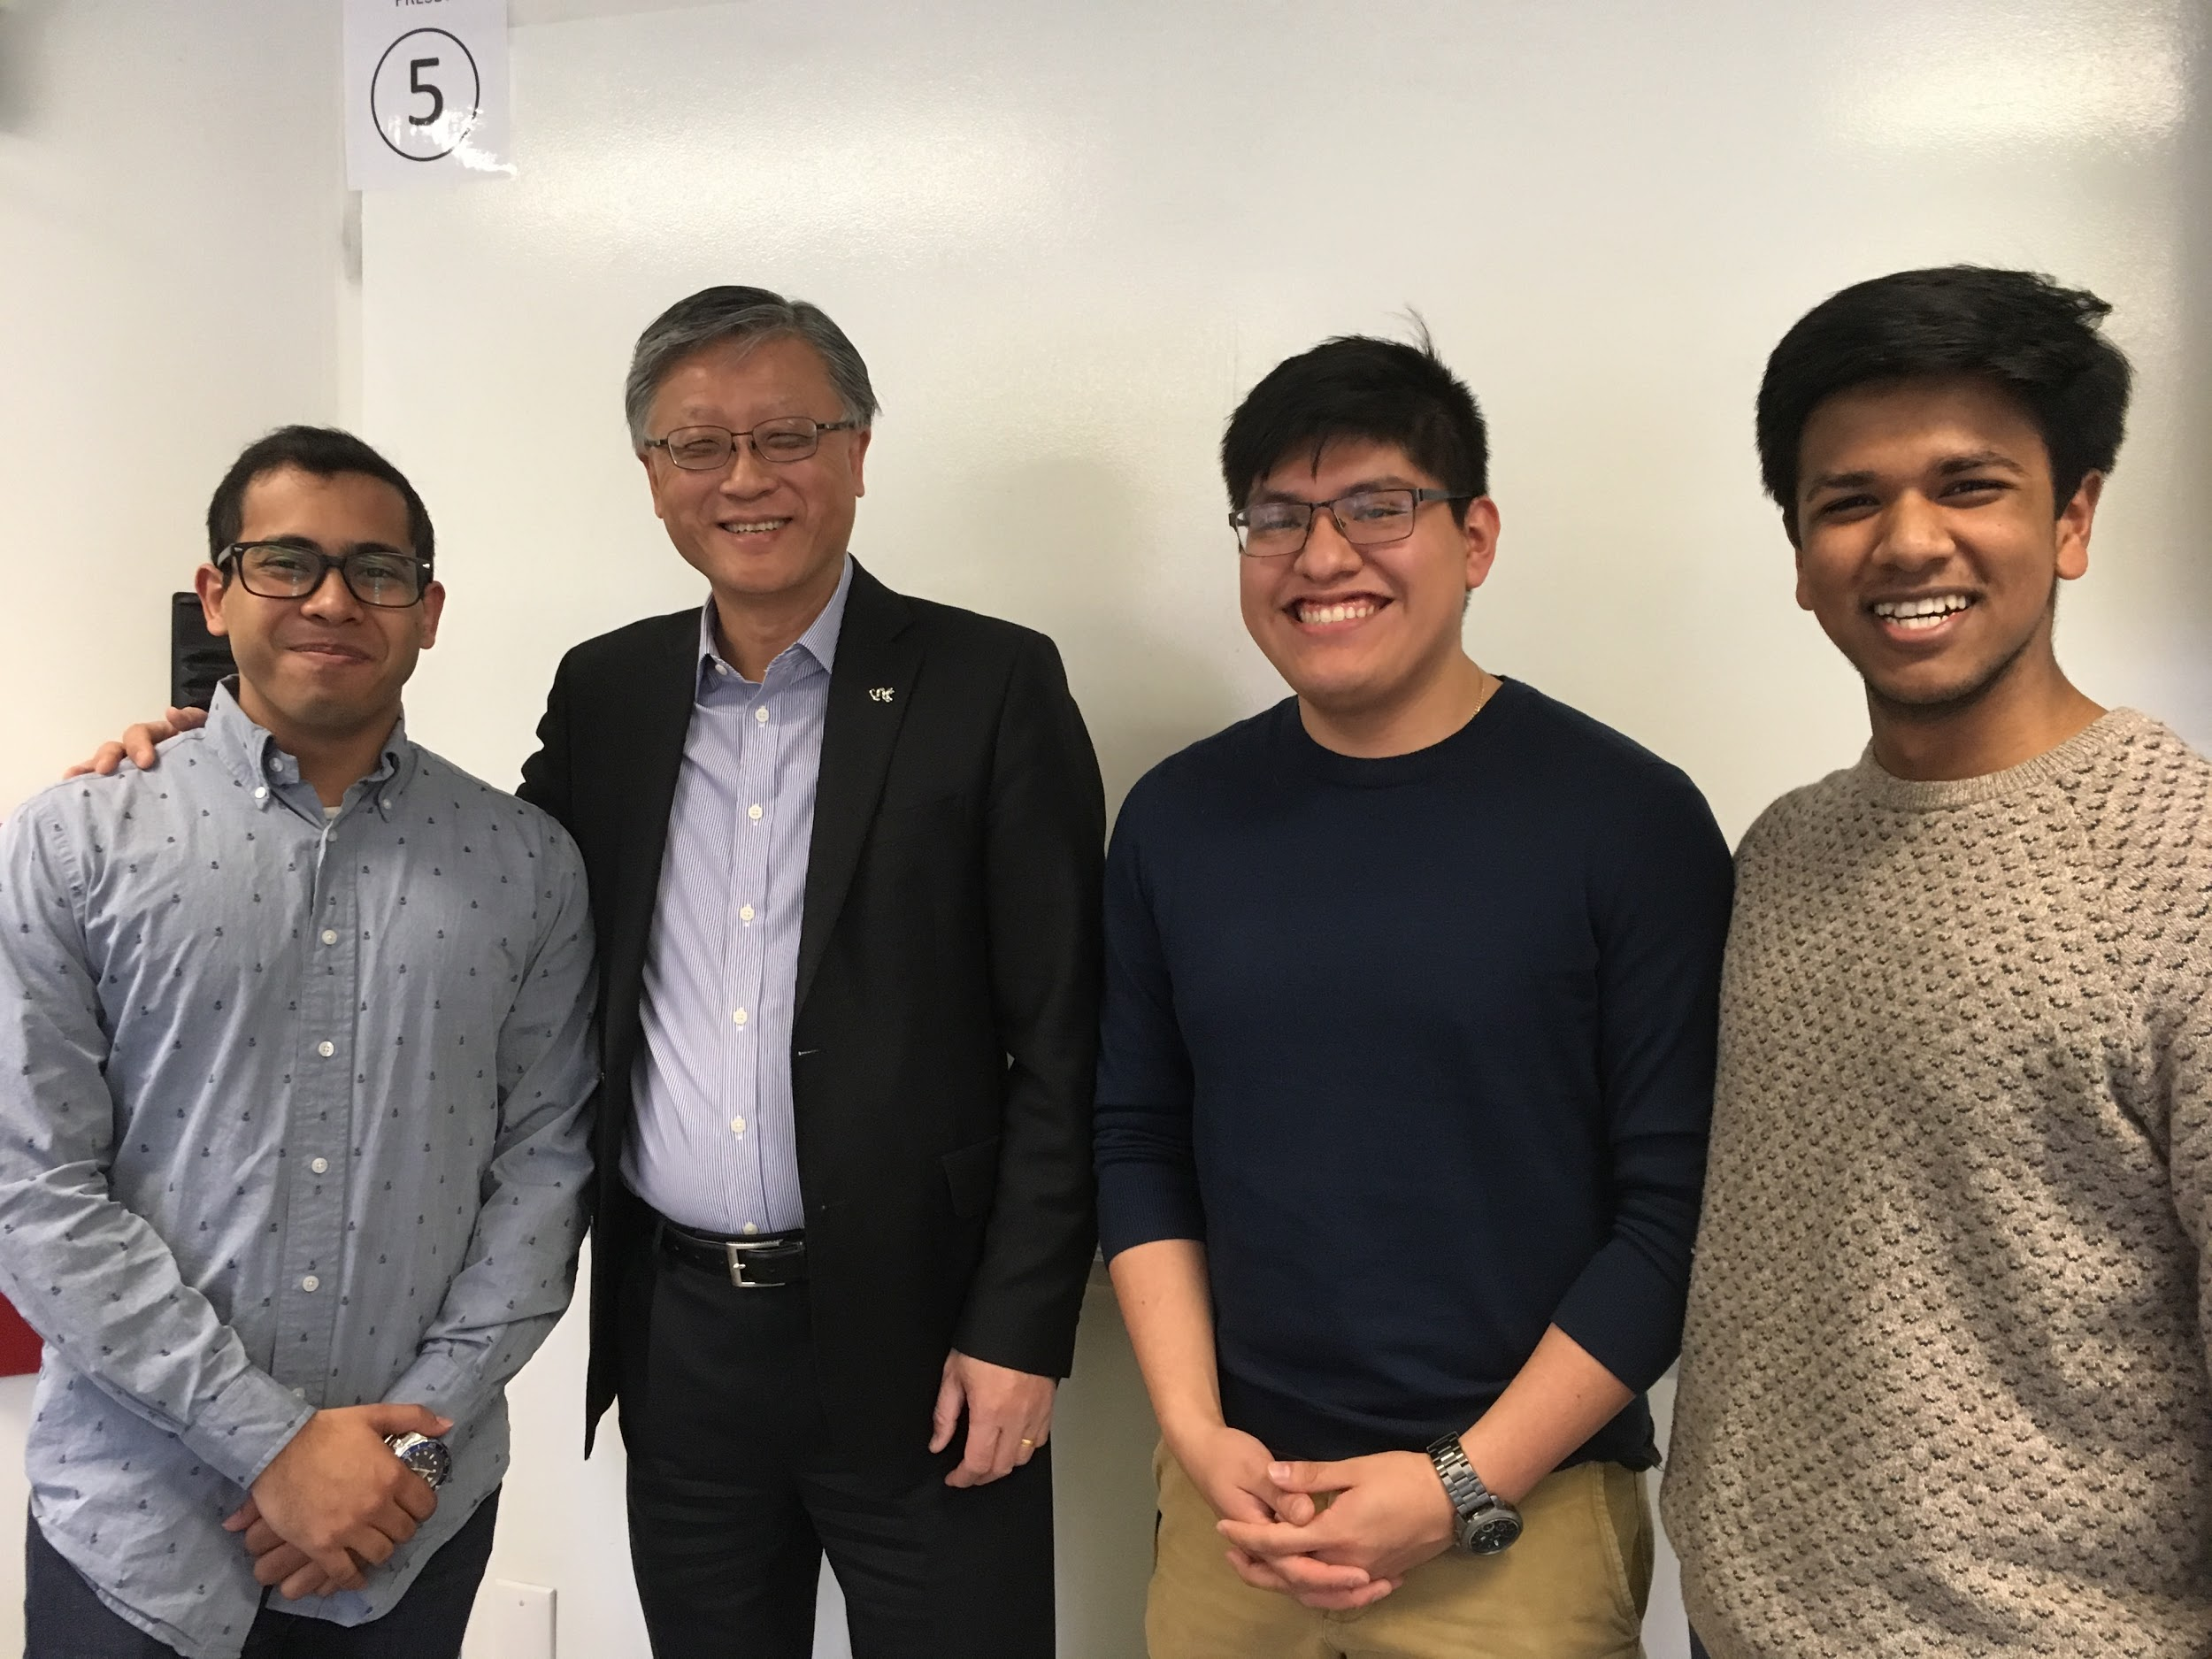
DragonEvents
Final Demo

Slide 10
Lessons Learned
Firebase
Pug
Forms
Email

Slide 11

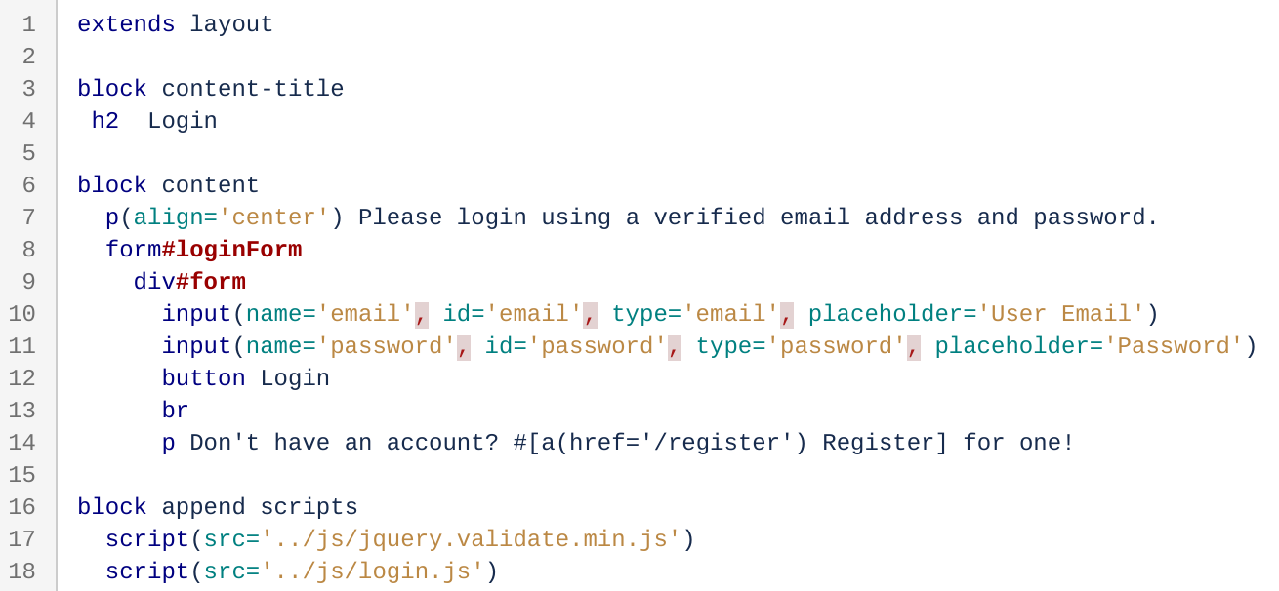
Pug
Template Inheritance
Pythonic Syntax

Slide 12

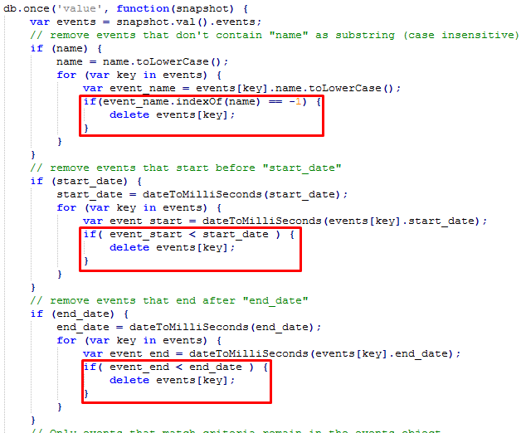
Firebase
Does not support traditional parametric querying
Solution:

Slide 13
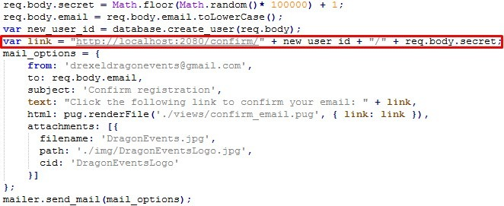
Email
Confirm email (Registration link)

Slide 14

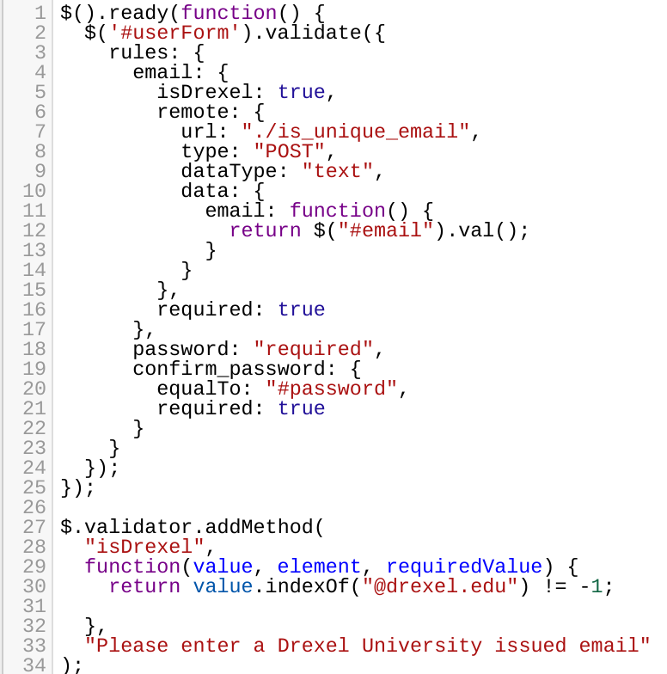
Forms
Most actions could be resolved with a form
E.g. Login, View event, submit event
Jquery Validation
remote
equalTo
addMethod

